Slide 1
Natural Language Processing Specialization Part of Speech Tagging
(2021 Deeplearning.ai)
YangXi’s Reading Notes

Slide 2

Part of Speech (POS)
POS tags:
POS tags describe the characteristics structure of the lexical terms in the sentences or text.
POS tags can be used to make assumptions of semantics
Applications including
named entities identification
co-reference resolution
speech recognition
POS tagging is the process of assigning the POS tags to the words in your sentences or corpus.
lexical term | tag | example
noun | NN | something, nothing
verb | VB | learn, study
determiner | DT | the, a
w-adverb | WRB | why, where
… | …

Slide 3
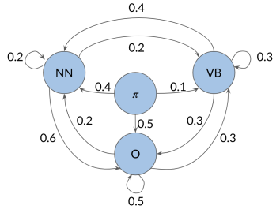

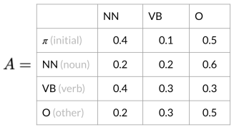
Markov Chains
Let’s start with a simple idea:
Say, the word after a verb:
60% probability is a noun; 20% probability is another verb; …
Markov chains are a type of stochastic model that describes a sequence of possible events.
Markov Property: the transition probability of the next event only depends on the current event.
A stochastic model incorporates, and models processes that have a random component to them
A Markov chain can be depicted as a directed graph.
A state (circle) refers to a certain condition of the present moment
The Transition Matrix is an equivalent, but more compact representation of the Markov chain model
An NxN matrix, where N is the number of states
The row sum should equal to 1

Slide 4
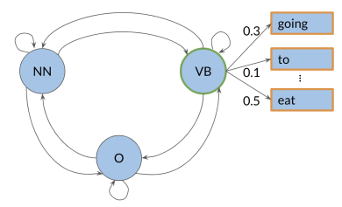
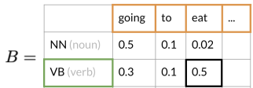
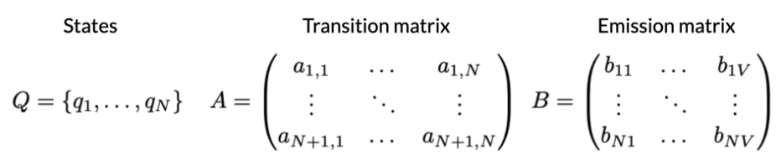
Hidden Markov Models
“Hidden” implies that the states are hidden or not directly observable
The words themselves are observable by the machine
The POS tags are NOT directly observable from the text
Emission Probabilities describe the transition from the hidden states (POS tags) to the observables (the words)
For example: when the model is currently at the hidden state of a verb, there is a 50% chance that the observable the model will emit is the word “eat”.
The Emission Matrix
The row sum should equal to 1

Slide 5
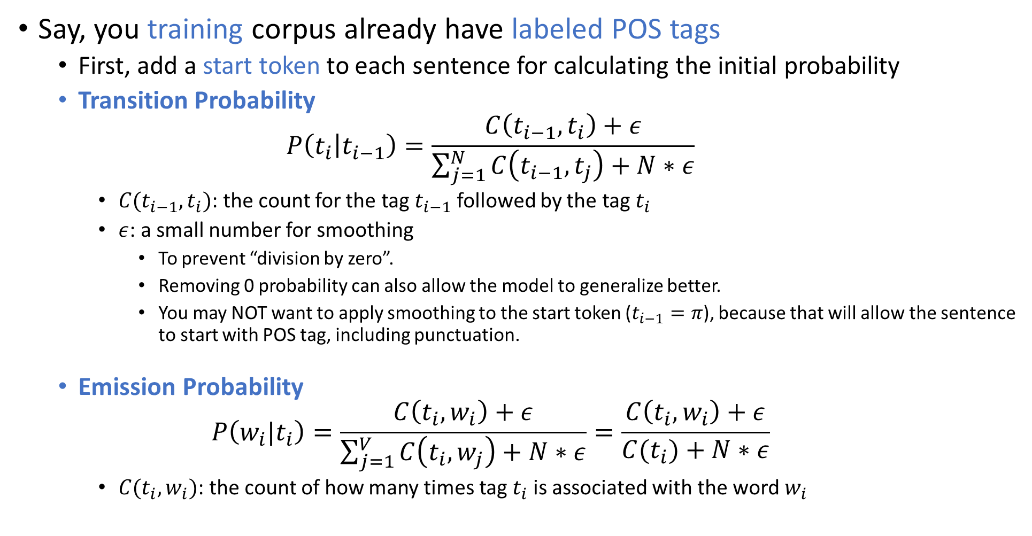
Populate Transition and Emission Matrix
Say, you training corpus already have labeled POS tags
First, add a start token to each sentence for calculating the initial probability
Transition Probability $P\left(t_{i} | t_{i−1}\right)=\frac{C\left(t_{i−1},t_{i}\right)+ε}{\sum_{j=1}^{N}{C\left(t_{i−1},t_{j}\right)}+N∗ε}$
$C(t_{i−1},t_{i})$: the count for the tag $t_{i−1}$ followed by the tag $t_{i}$
$ε$: a small number for smoothing
To prevent “division by zero”.
Removing 0 probability can also allow the model to generalize better.
You may NOT want to apply smoothing to the start token ($t_{i−1}=π$), because that will allow the sentence to start with POS tag, including punctuation.
Emission Probability $P\left(w_{i}|t_{i}\right)=\frac{C\left(t_{i},w_{i}\right)+ε}{\sum_{j=1}^{V}{C\left(t_{i},w_{j}\right)}+N∗ε}=\frac{C\left(t_{i},w_{i}\right)+ε}{C(t_{i})+N∗ε}$
$C(t_{i},w_{i})$: the count of how many times tag $t_{i}$ is associated with the word $w_{i}$

Slide 6
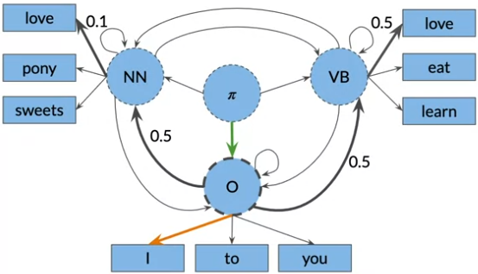
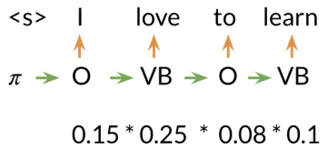
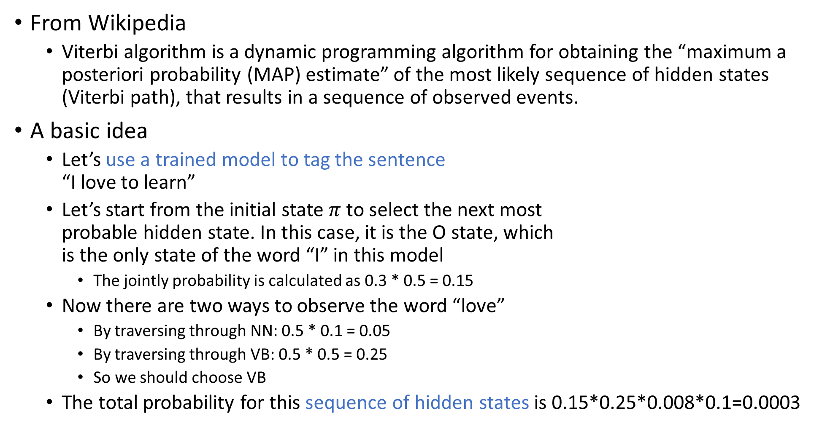
The Viterbi Algorithm
From Wikipedia
Viterbi algorithm is a dynamic programming algorithm for obtaining the “maximum a posteriori probability (MAP) estimate” of the most likely sequence of hidden states (Viterbi path), that results in a sequence of observed events.
A basic idea
Let’s use a trained model to tag the sentence “I love to learn”
Let’s start from the initial state $π$ to select the next most probable hidden state. In this case, it is the O state, which is the only state of the word “I” in this model
The jointly probability is calculated as 0.3 * 0.5 = 0.15
Now there are two ways to observe the word “love”
By traversing through NN: 0.5 * 0.1 = 0.05
By traversing through VB: 0.5 * 0.5 = 0.25
So we should choose VB
The total probability for this sequence of hidden states is 0.15*0.25*0.008*0.1=0.0003

Slide 7
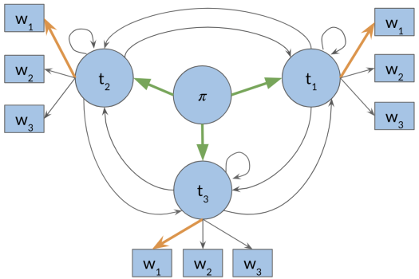
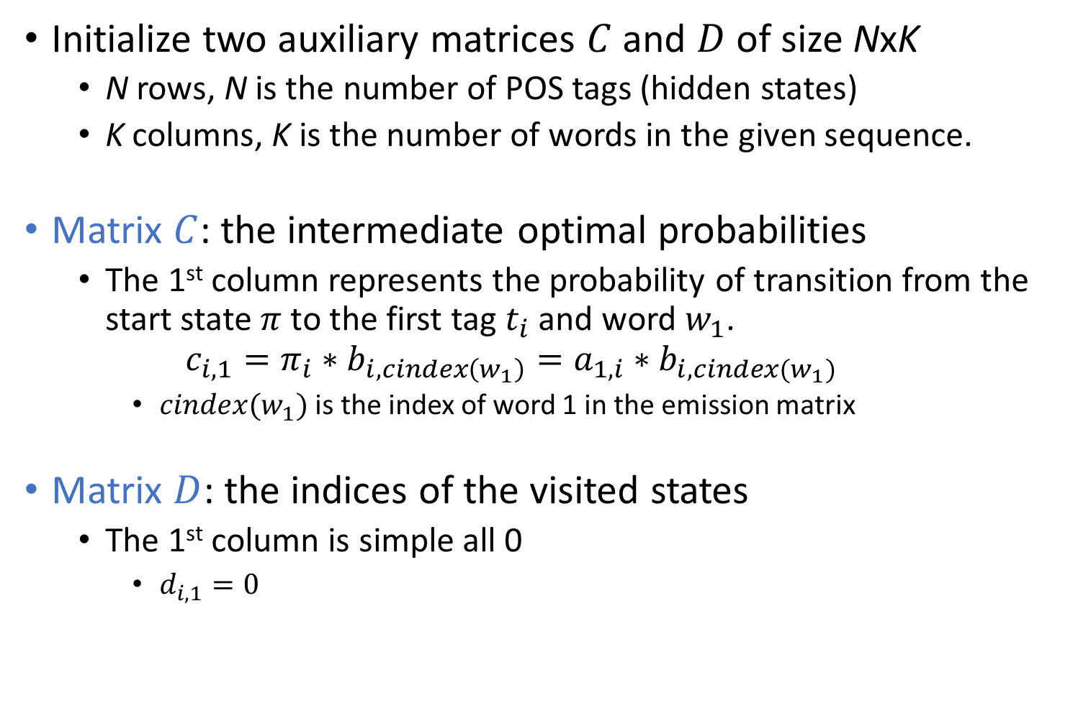
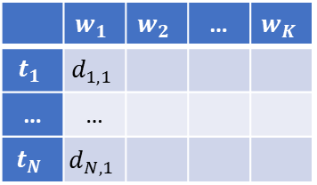
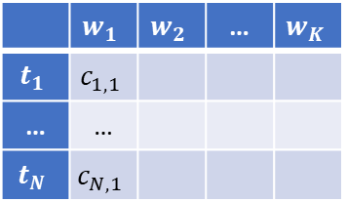
Viterbi Algorithm – Initialization
Initialize two auxiliary matrices $C$ and $D$ of size NxK
N rows, N is the number of POS tags (hidden states)
K columns, K is the number of words in the given sequence.
Matrix $C$: the intermediate optimal probabilities
The 1st column represents the probability of transition from the start state $π$ to the first tag $t_{i}$ and word $w_{1}$. $c_{i,1}=π_{i}∗b_{i,cindex\left(w_{1}\right)}=a_{1,i}∗b_{i,cindex(w_{1})}$
$cindex(w_{1})$ is the index of word 1 in the emission matrix
Matrix $D$: the indices of the visited states
The 1st column is simple all 0
$d_{i,1}=0$
 | $$w_{1}$$ | $$w_{2}$$ | … | $$w_{K}$$
$$t_{1}$$ | $$c_{1,1}$$
… | …
$$t_{N}$$ | $$c_{N,1}$$
C =
 | $$w_{1}$$ | $$w_{2}$$ | … | $$w_{K}$$
$$t_{1}$$ | $$d_{1,1}$$
… | …
$$t_{N}$$ | $$d_{N,1}$$
D =

Slide 8
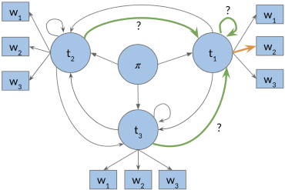
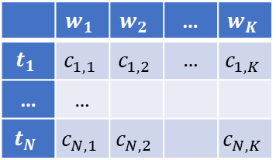
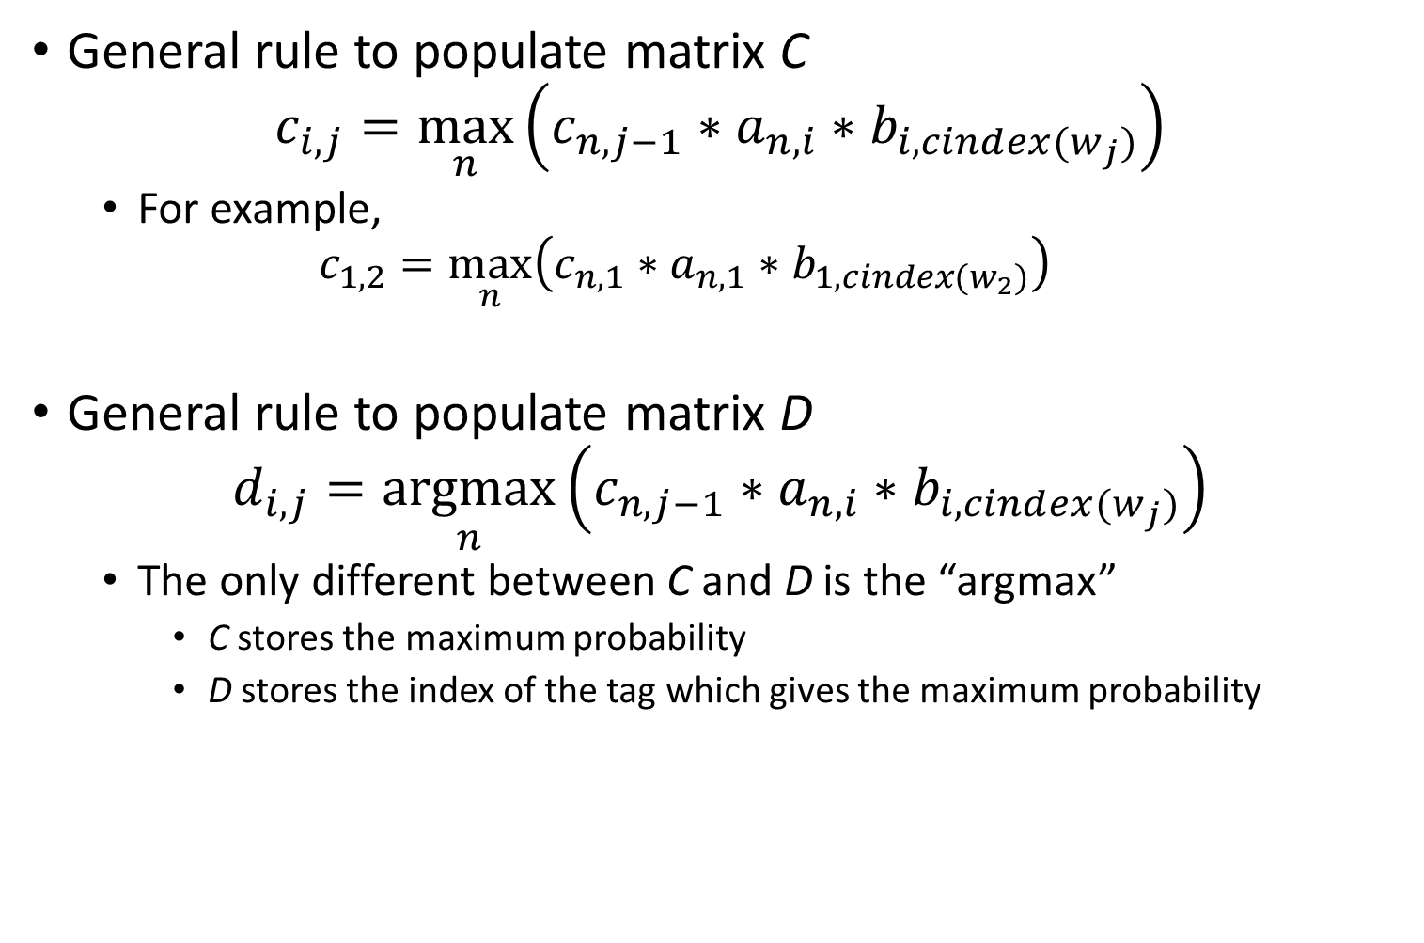
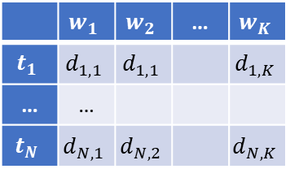
Viterbi Algorithm – Forward Pass
General rule to populate matrix C $c_{i,j}=\max_{n}\left(c_{n,j−1}∗a_{n,i}∗b_{i,cindex(w_{j})}\right)$
For example, $c_{1,2}=\max_{n}\left(c_{n,1}∗a_{n,1}∗b_{1,cindex(w_{2})}\right)$
General rule to populate matrix D $d_{i,j}=\underset{n}{argmax}\left(c_{n,j−1}∗a_{n,i}∗b_{i,cindex(w_{j})}\right)$
The only different between C and D is the “argmax”
C stores the maximum probability
D stores the index of the tag which gives the maximum probability
 | $$w_{1}$$ | $$w_{2}$$ | … | $$w_{K}$$
$$t_{1}$$ | $$c_{1,1}$$ | $$c_{1,2}$$ | … | $$c_{1,K}$$
… | …
$$t_{N}$$ | $$c_{N,1}$$ | $$c_{N,2}$$ |  | $$c_{N,K}$$
C =
 | $$w_{1}$$ | $$w_{2}$$ | … | $$w_{K}$$
$$t_{1}$$ | $$d_{1,1}$$ | $$d_{1,1}$$ |  | $$d_{1,K}$$
… | …
$$t_{N}$$ | $$d_{N,1}$$ | $$d_{N,2}$$ |  | $$d_{N,K}$$
D =

Slide 9
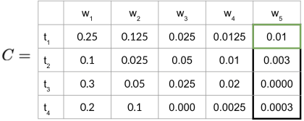
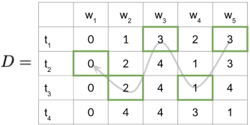

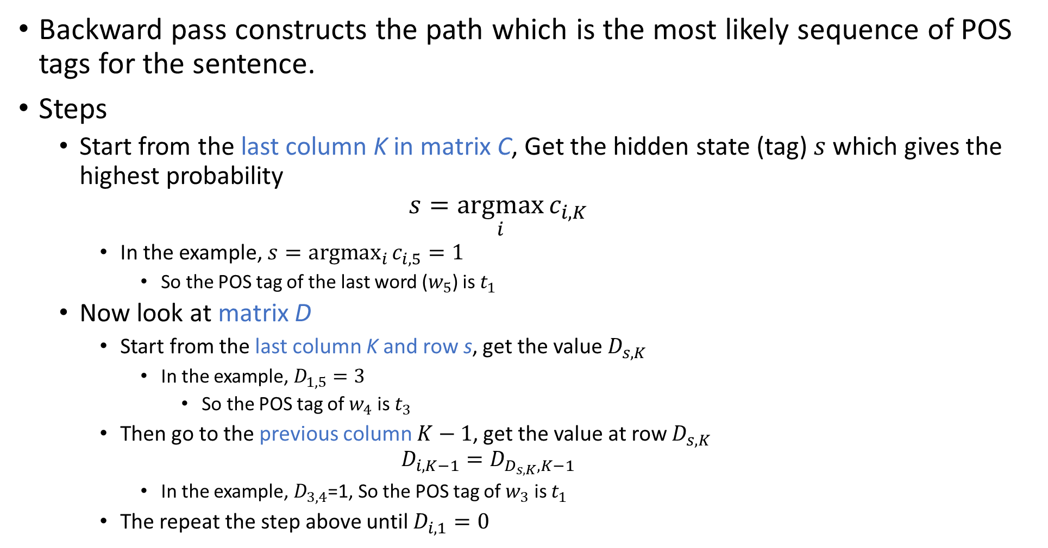
Viterbi Algorithm – Backward Pass
Backward pass constructs the path which is the most likely sequence of POS tags for the sentence.
Steps
Start from the last column K in matrix C, Get the hidden state (tag) $s$ which gives the highest probability $s=\underset{i}{argmax}{c_{i,K}}$
In the example, $s=\underset{i}{argmax}{c_{i,5}}=1$
So the POS tag of the last word ($w_{5}$) is $t_{1}$
Now look at matrix D
Start from the last column K and row s, get the value $D_{s,K}$
In the example, $D_{1,5}=3$
So the POS tag of $w_{4}$ is $t_{3}$
Then go to the previous column $K−1$, get the value at row $D_{s,K}$ $D_{i,K−1}=D_{D_{s,K},K−1}$
In the example, $D_{3,4}$=1, So the POS tag of $w_{3}$ is $t_{1}$
The repeat the step above until $D_{i,1}=0$

Slide 10

Viterbi Algorithm – Implementation Notes
Use log probabilities to handle multiplying small numbers $\log\left(c_{i,j}\right)=\max_{k}\left(\log\left(c_{k,j−1}\right)+\log\left(a_{k,i}\right)+\log\left(b_{i,cindex(w_{j})}\right)\right)$
In python, index starts with 0

